Slide 1
Module Test
Lecture #4.5

Slide 2
Welcome to the module test
Welcome to your first module test
In this module you will be using all of your knowledge gained so far to create the UI for a travel app
You need to design a -
Welcome screen (With sing in / sign up options)
A homescreen (with search and scroll options)
And a detail view screen (to show details of a trip that user will select)
Just make the design now. No need to add functionality.

Slide 3
Resources
Some sample design is included for your help. You can choose to ditto copy one of them or design you own. Just make sure you keep up with the standard of design shown here
These snapshots are taken from www.dribbble.com which is an excellent place to look for design motivation
For asset images, headover to any copyright free image site like www.pexels.com
For icons and colors, go to www.materialpalette.com
Or go to www.flaticon.com for virtually infinite free icons

Slide 4
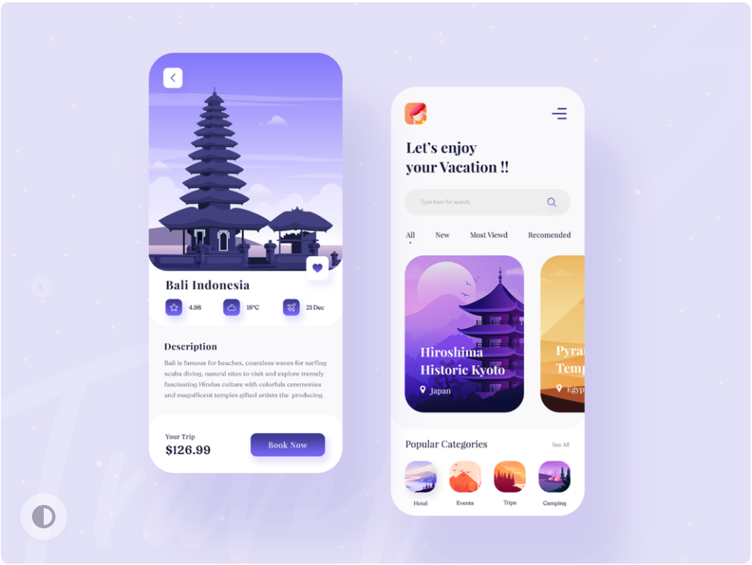
Sample UI
Source: https://dribbble.com/shots/12161508-Travel-Service-App-Design

Slide 5
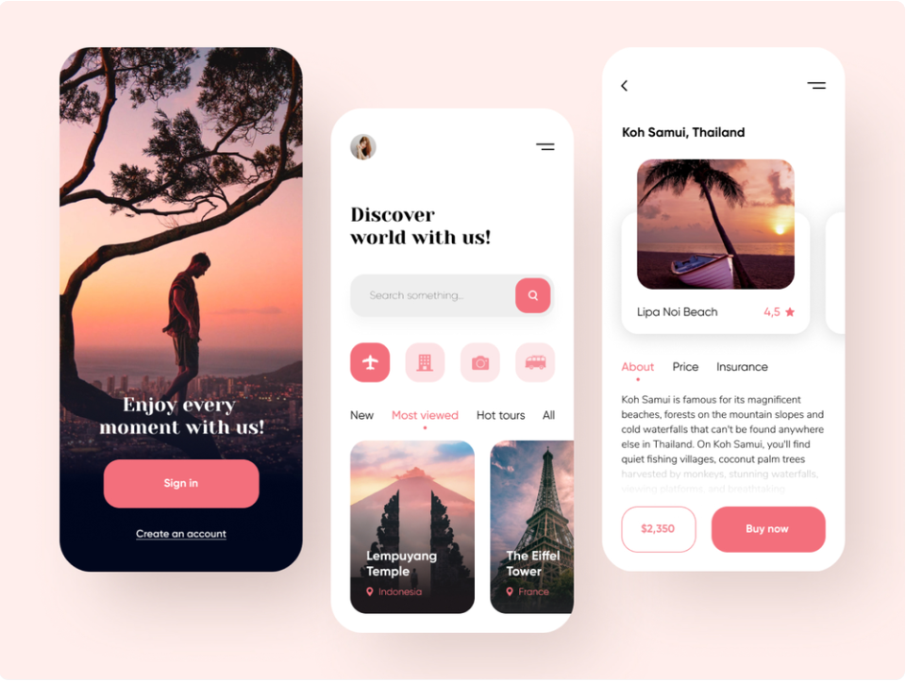
Sample UI
Source: https://dribbble.com/shots/10901698-Travel-service-Mobile-App

Slide 6
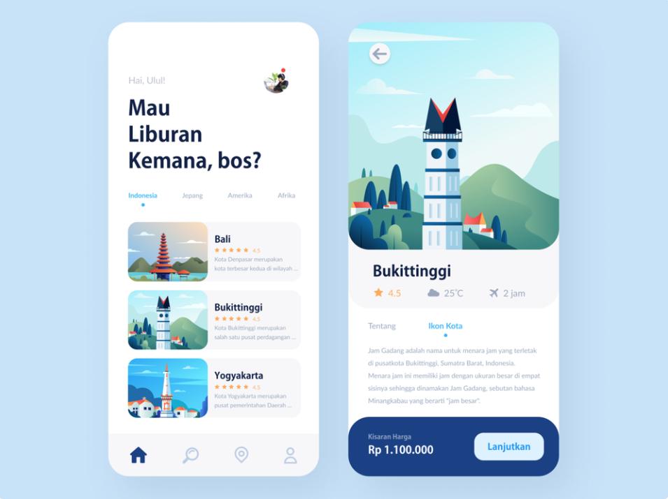
Sample UI
Source: https://dribbble.com/shots/8157039-Travel-App

Slide 7
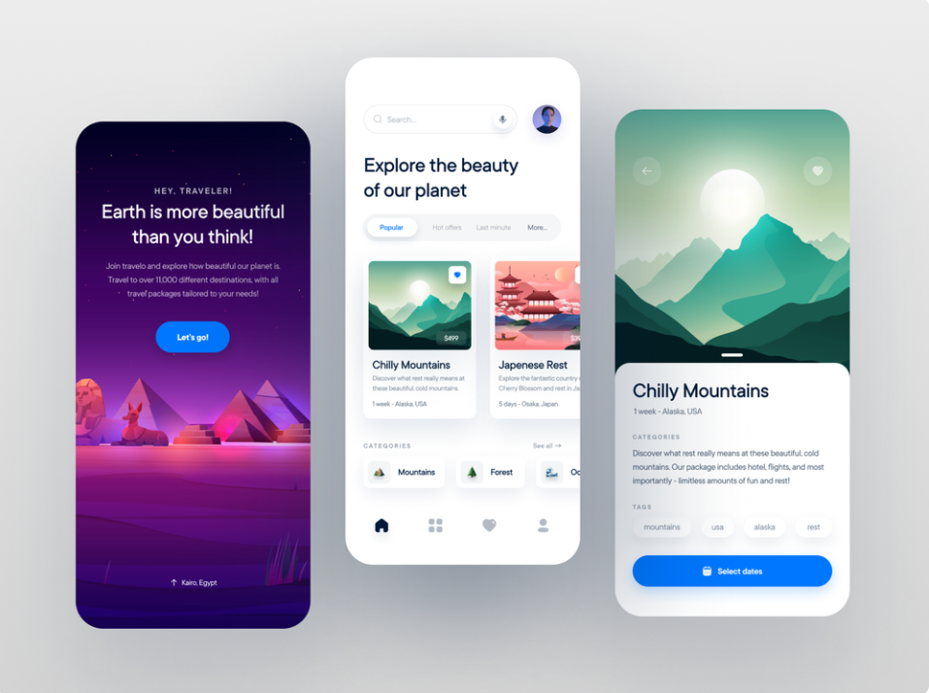
Sample UI
Source: https://dribbble.com/shots/15047664-Travel-Service-Mobile-App

Slide 8
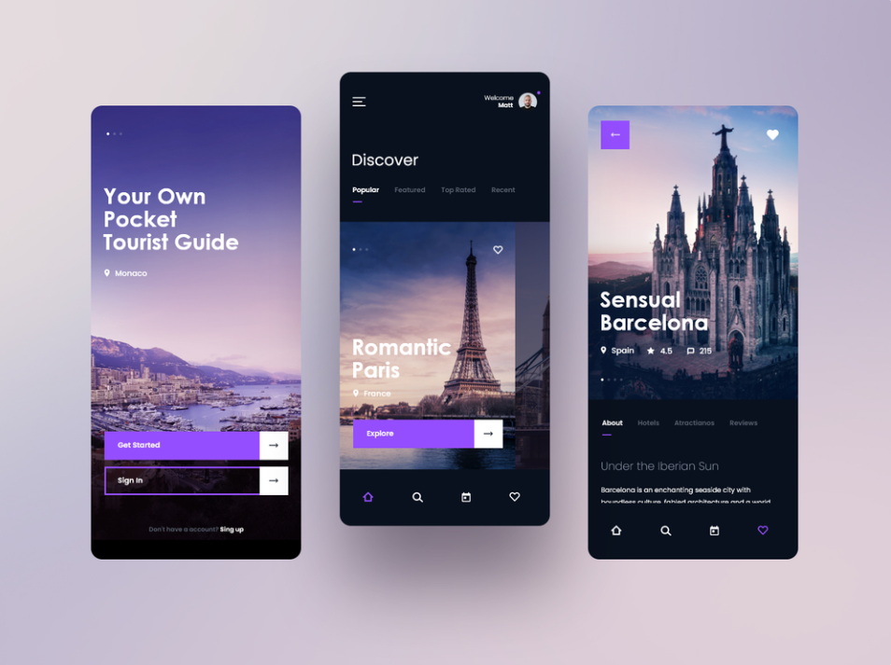
Sample UI
Source: https://dribbble.com/shots/14953592--25-Tourist-Guide-MobileApp-Concept

Slide 9
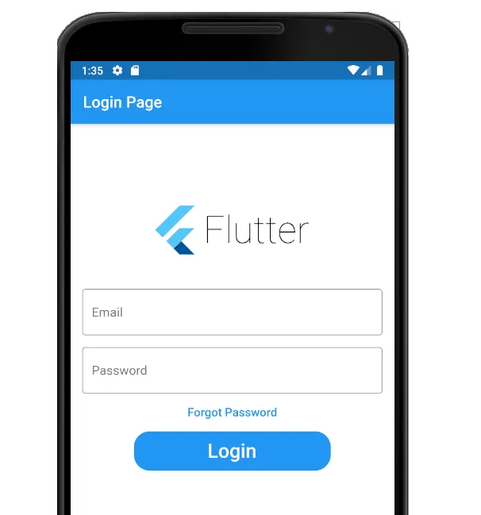
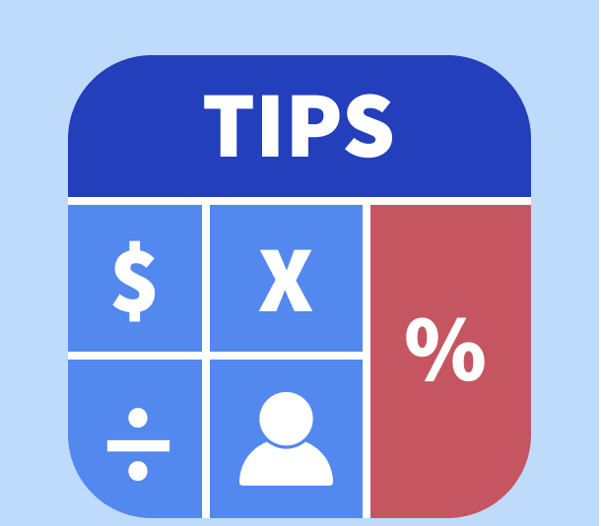
Test 2 and 3

Slide 11
All the best!

